Slide 1
Chapter 3 Introduction to Classes, Objects Methods and Strings

Slide 2
O b j e c t i v e s
In this chapter you’ll learn:
How to declare a class and use it to create an object.
How to implement a class’s behaviors as methods.
How to implement a class’s attributes as instance variables and properties.
How to call an object’s methods to make them perform their tasks.
What local variables of a method are and how they differ from instance variables.
What primitive types and reference types are.
How to use a constructor to initialize an object’s data.
How to represent and use numbers containing decimal points.

Slide 3
3.1 Introduction
Covered in this chapter
Classes
Objects
Methods
Parameters
Floating-point numbers

Slide 4
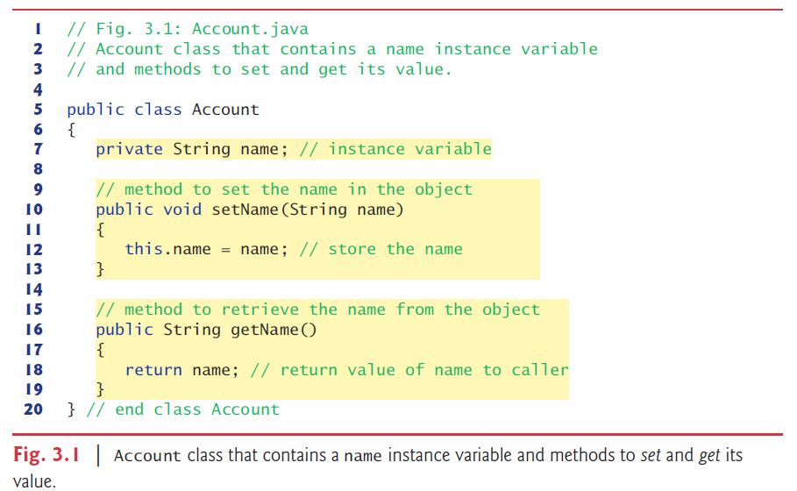
3.2 Instance Variables, set Methods and get Methods

Slide 5
3.2 Instance Variables, set Methods and get Methods
The class declaration begins in line 5:
Instance Variable name:
declared inside a class declaration but outside the bodies of the class’s methods

Slide 6
Good Programming Practice 3.1
We prefer to list a class’s instance variables first in the class’s body, so that you see the names and types of the variables before they’re used in the class’s methods. You can list the class’s instance variables anywhere in the class outside its method declarations, but scattering the instance variables can lead to hard-to-read code.

Slide 7
Controlling Access to Members
Member access modifiers
public
Variables and methods accessible to clients of the class and its subclass
private
Variables and methods not accessible to clients of the class
Only accessible in methods of that superclass
Declaring instance variables private is known as data hiding
protected
Can accessible by methods of the superclass, by methods of subclasses and by methods of other class in the same package
default
Control access to class’s variables and methods
A member that is not declared public, protected, or private is said to have default access and may be accessed from, and only from, anywhere in the package in which it is declared.

Slide 8
argument
Method setName receives parameter name of type String—which represents the name that will be passed to the method as an argument.
Parameters are local variables.
this
The method’s body can use the keyword this to refer to the shadowed instance variable explicitly.
return
The method’s return type (which appears before the method name) specifies the type of data the method returns to its caller after performing its task.

Slide 9
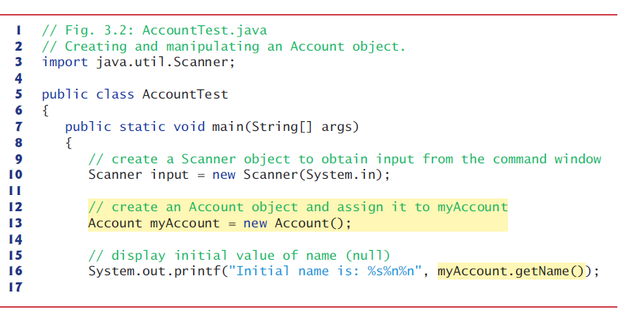
Driver Class AccountTest

Slide 10
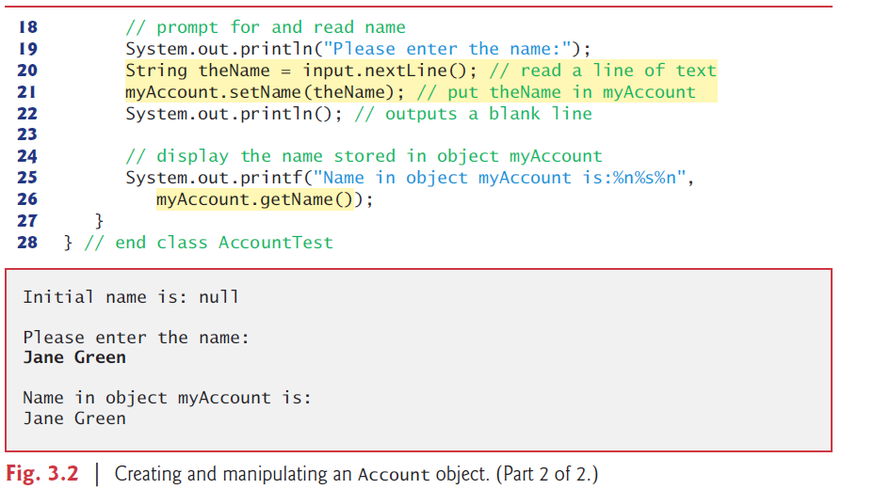

Slide 11
new
Keyword new creates a new object of the specified class
Calling Class Account’s getName Method
object followed by a dot separator (.)
The number of arguments in a method call must match the number of parameters in the method declaration’s parameter list
null—the Default Initial Value for String Variables
Unlike local variables, which are not automatically initialized, every instance variable has a default initial value

Slide 12
Compiling and Executing an App with Multiple Classes
javac Account.java AccountTest.java
Javac *.java

Slide 13
Notes on import Declarations
Classes System and String are in package java.lang
Implicitly imported into every Java program
Can use the java.lang classes without explicitly importing them
Most classes you’ll use in Java programs must be imported explicitly.
Classes that are compiled in the same directory on disk are in the same package—known as the default package.
Classes in the same package are implicitly imported into the source-code files of other classes in the same package.
An import declaration is not required if you always refer to a class via its fully qualified class name
Package name followed by a dot (.) and the class name.

Slide 14
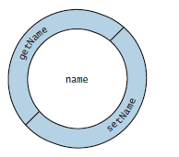
Software Engineering with private Instance Variables and public set and get Methods
Conceptual View of an Account Object with Encapsulated Data
Any client code that needs to interact with the Account object can do
so only by calling the public methods of the protective outer layer.

Slide 15
3.3 Primitive Types vs. Reference Types
Types in Java
Primitive
boolean, byte, char, short, int, long, float, double
Reference (sometimes called nonprimitive types)
All non primitive types are reference types.
Objects
Default value of null
Used to invoke an object’s methods
Example: TestDefaultValue.java

Slide 16
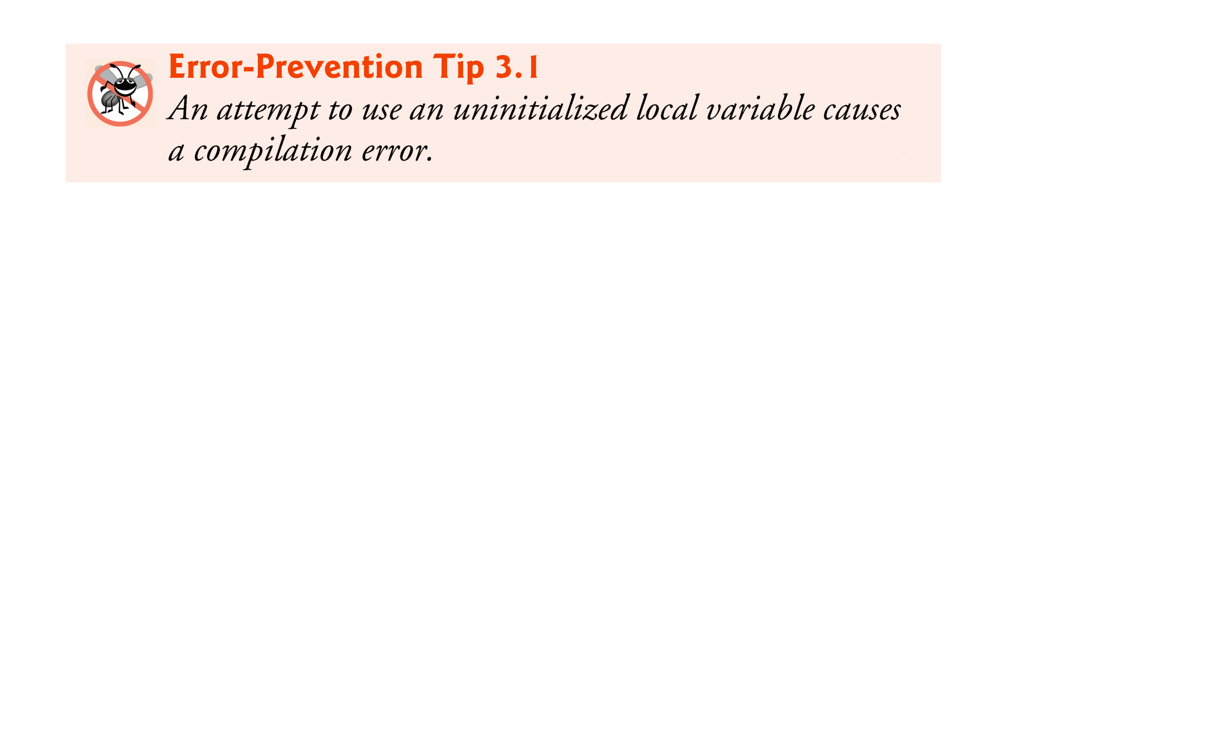

Slide 17
3.4 Primitive Types vs. Reference Types
Programs use variables of reference types (normally called references) to store the locations of objects in the computer’s memory.
Such a variable is said to refer to an object in the program.
When using an object of another class, a reference to the object is required to invoke (i.e., call) its methods.
Also known as sending messages to an object.

Slide 18
3.4 Initializing Objects with Constructors
When an object of a class is created, its instance variables are initialized by default.
Java requires a constructor call for every object that is created.
Keyword new
A constructor must have the same name as the class.

Slide 19
3.4 Initializing Objects with Constructors (Cont.)
By default, the compiler provides a default constructor with no parameters
A constructor’s parameter list specifies the data it requires to perform its task.
Constructors cannot return values, so they cannot specify a return type.
Normally, constructors are declared public.
If you declare any constructors for a class, the Java compiler will not create a default constructor for that class.

Slide 20
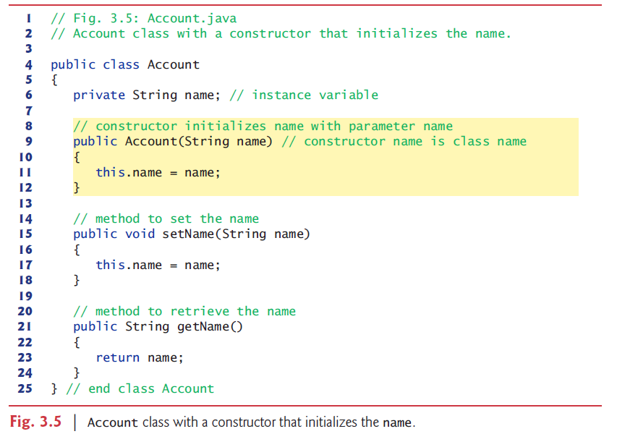

Slide 21
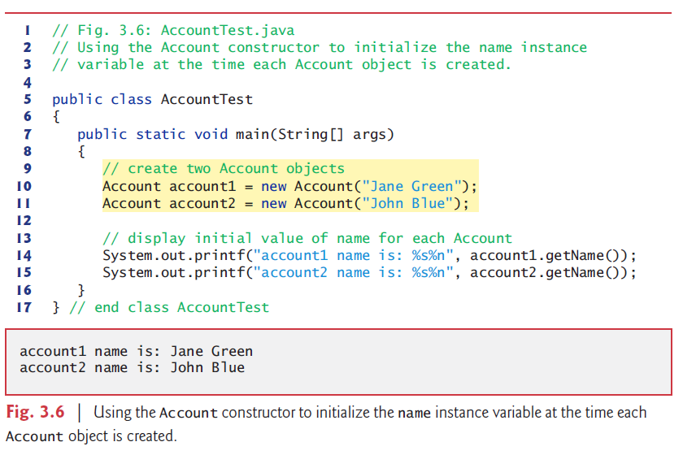

Slide 22
3.5 Floating-Point Numbers and Type double
Floating-point number
A number with a decimal point, such as 7.33, 0.0975 or 1000.12345).
float and double primitive types
double variables can store numbers with larger magnitude and finer detail than float variables.
float represents single-precision floating-point numbers up to 7 significant digits.
double represents double-precision floating-point numbers that require twice as much memory as float and provide 15 significant digits—approximately double the precision of float variables.

Slide 23
3.5 Floating-Point Numbers and Type double (Cont.)
Java treats all floating-point literals (such as 7.33 and 0.0975) as double values by default.
Appendix D, Primitive Types shows the ranges of values for floats and doubles.

Slide 24
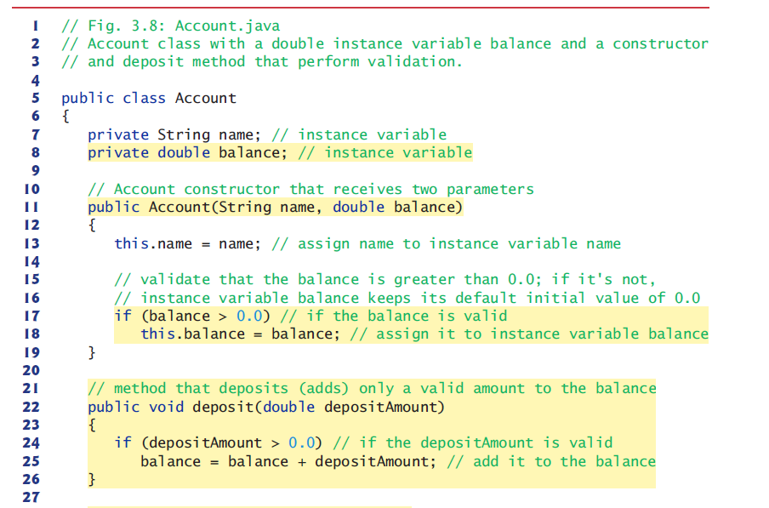

Slide 25
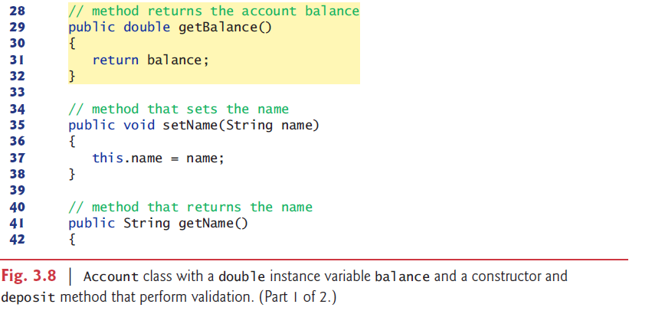

Slide 26
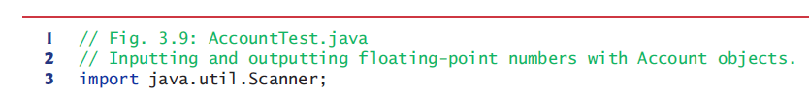
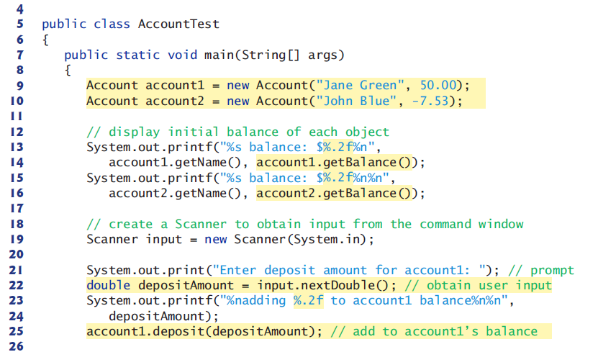

Slide 27
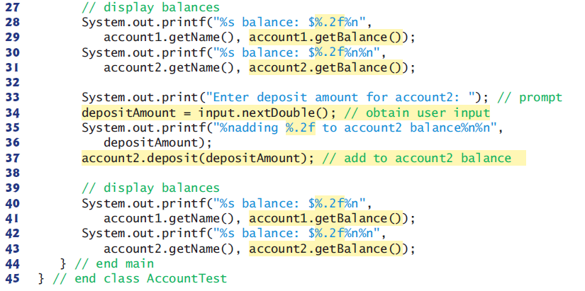

Slide 28
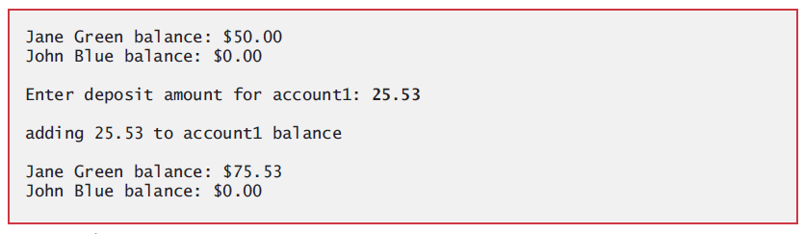
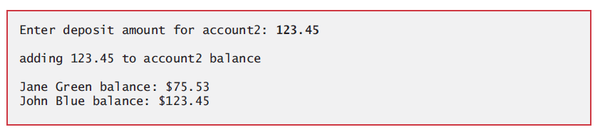

Slide 29
System.out.printf
Format specifier %.2f
%f is used to output values of type float or double.
.2 represents the number of decimal places (2) to output to the right of the decimal point—known as the number’s precision.
Any floating-point value output with %.2f will be rounded to the hundredths position.
Scanner method nextDouble returns a double value entered by the user.

Slide 30
BigDecimal class
Immutable, arbitrary-precision signed decimal numbers.
Provides operations for arithmetic, scale manipulation, rounding, comparison, hashing, and format conversion.
Example: Arith.java

Slide 31
3.6 (Optional) GUI and Graphics Case Study: A Simple GUI
A graphical user interface (GUI) presents a user-friendly mechanism for interacting with an app.
A GUI(pronounced “GOO-ee”) gives an app a distinctive “look-and-feel”.
JavaFX—Java’s GUI, graphics and multimedia technology of the future.

Slide 32
3.6 (Optional) GUI and Graphics Case Study: A Simple GUI (Cont.)
GUIs are built from GUI components – JavaFX refers to these as controls.
Controls are GUI components, such as Label objects that display text.
Programs can respond to these events – known as event handling.

Slide 33

3.6 (Optional) GUI and Graphics Case Study: A Simple GUI (Cont.)
JavaFX Scene Builder and FXML
Scene Builder is a tool that enables you to create GUIs simply by dragging and dropping pre-built GUI components.
FXML(FX Markup Language) is a language for defining and arranging JavaFX GUI controls without writing any Java code.
You can download Scene Builder from:

Slide 34
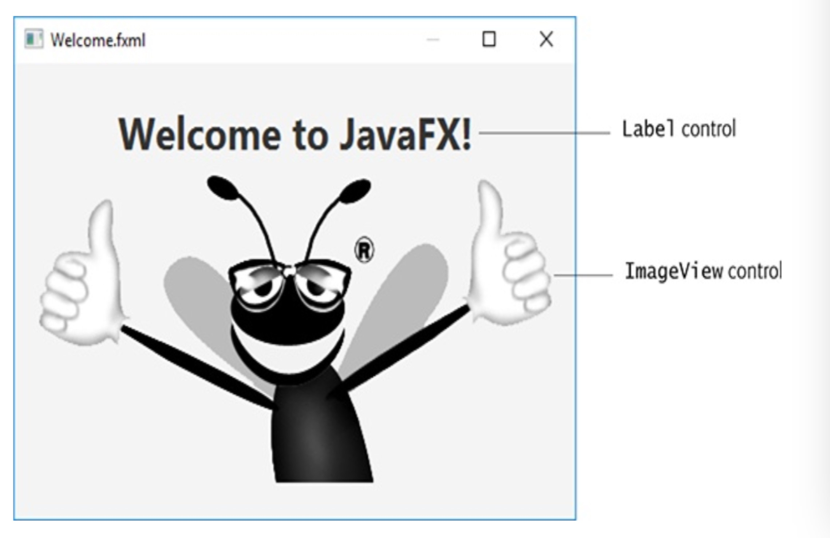
3.6 (Optional) GUI and Graphics Case Study: A Simple GUI (Cont.)
Welcome App – Displaying Text and an Image

Slide 35
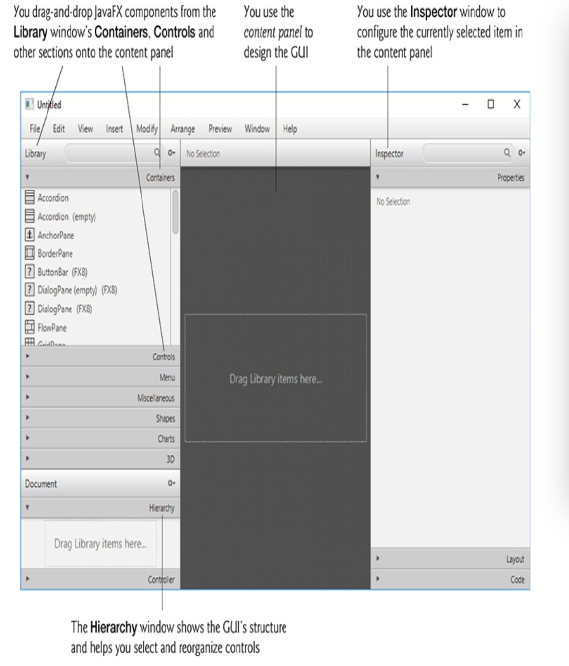
3.6 (Optional) GUI and Graphics Case Study: A Simple GUI (Cont.)

Slide 36
3.6 (Optional) GUI and Graphics Case Study: A Simple GUI (Cont.)
JavaFX layout container help you arrange and size controls.
For the VBox, set the following properties:
Alignment—center
PrefWidth, PrefHeight—450， 300
For the Label, set the following properties:
text — Welcome to JavaFX!
font — Style to Bold , Size to 30.
For the ImageView, set the following properties:
Image
Fit Width and Fit Height ——Reset to Default
Preview> Show Preview in Window
File > Save

